Slide 1

Java Zone Coffee Shop
Sarah Greene
Andrew Hoskins
Joseph Nguyen
Daiki Shinoda
Notes:
https://www.freepik.com/free-photo/coffee-beans-top-view-white-background-space-text_8060692.htm#page=1&query=coffee%20beans%20background&position=0&from_view=keyword

Slide 2

Summary
☕ Goal→ To create an online coffee shop with the sole purpose of delivery
☕ Influences→ COVID-19 Pandemic and desire for greater accessibility
Notes:
https://www.countryliving.com/life/g30755994/coffee-quotes/
Daiki

Slide 3
How the work was divided
Sarah
Use Case Diagram
ER Diagram
Create SQL database
Home page
Fixing bugs
Styling
Joseph
CRUD Matrix
Cart Pages and Functionality
Checkout Pages and Functionality
Fixing bugs
Styling
Andrew
Navigational Chart
Food Page
Fixing bugs
Styling
Javascript
Validating inputs
Login/Register Page
Daiki
Relational Schema
Drink Page
Fixing bugs
Styling
Validating inputs
Login/Register Page

Slide 4

Use Case Diagram
Notes:
https://unsplash.com/photos/ItaV89TNkks

Slide 5
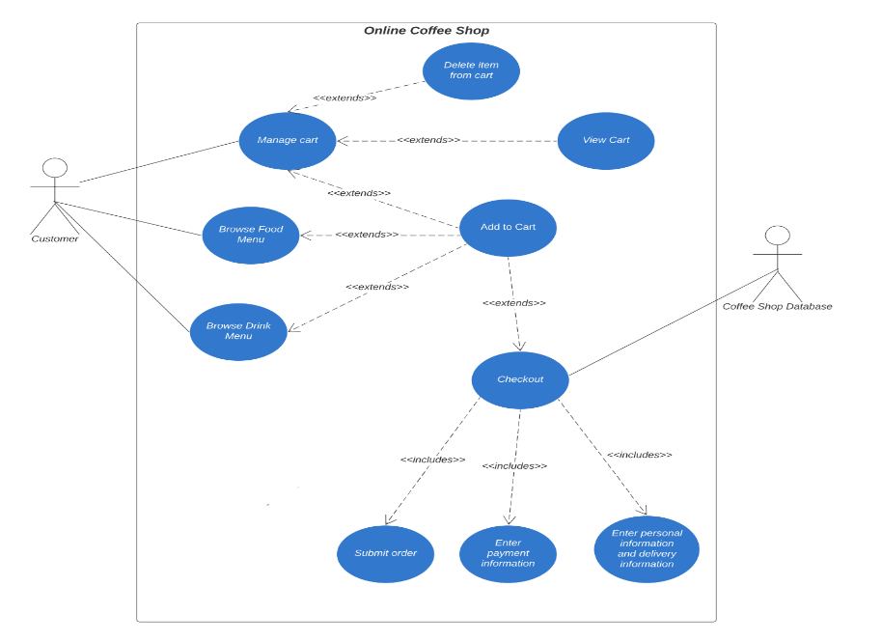
Notes:
Sarah

Slide 6

ER Diagram
Notes:
https://unsplash.com/photos/6VhPY27jdps

Slide 7
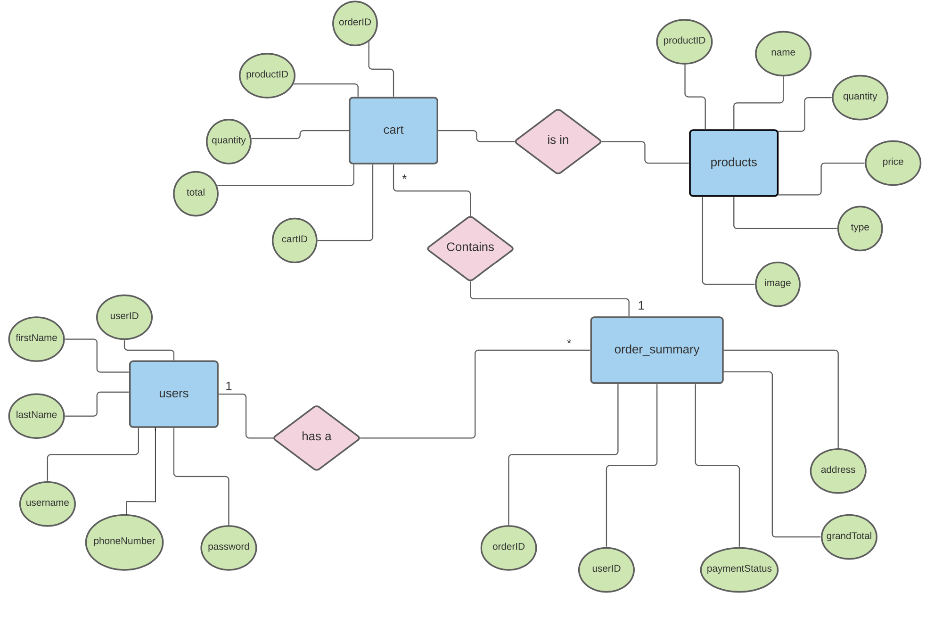
Notes:
Sarah
There can be multiple products in one cart and one order summary per cart and every registered user that checks out has an order summary

Slide 8

Navigational Chart
Notes:
https://unsplash.com/photos/TsNwtbCih0M
Andrew

Slide 9
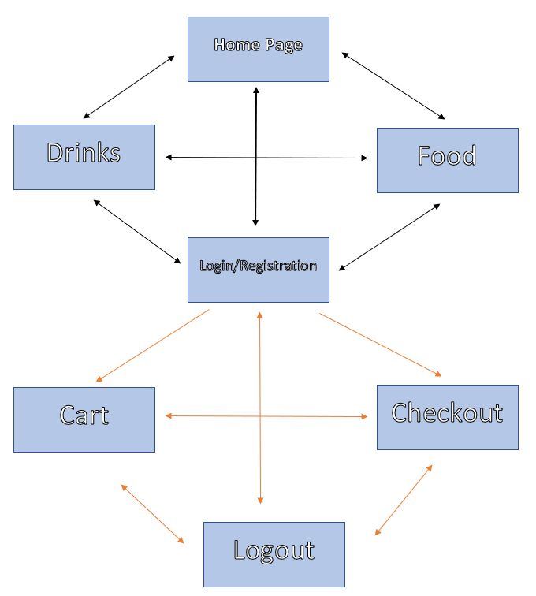
To reach our menu, you are not required to login into an account. The orange arrows indicate two things. One is that the user is logged in and the other is that any of the prior pages of login/registration are accessible to those pages. The only way to access our login/registration page after the user has logged in is by the logout page. The orange arrows also serve a purpose of reducing visual clutter.
Notes:
Andrew

Slide 10

CRUD Matrix
Notes:
Joseph

Slide 11
CSCI 4300 Group 6 Project CRUD Matrix
Forms x Tables | Products | Customers | Orders | Order Details
Home | R
Foods | RU
Drinks | RU
Cart | RU |  | RU | RU
Checkout |  | CRU | CRU | CRU
phpMyAdmin | C
Notes:
Joseph

Slide 12
Demo
Notes:
** Show source code before demo → ****have open just in case
Sarah

Slide 13
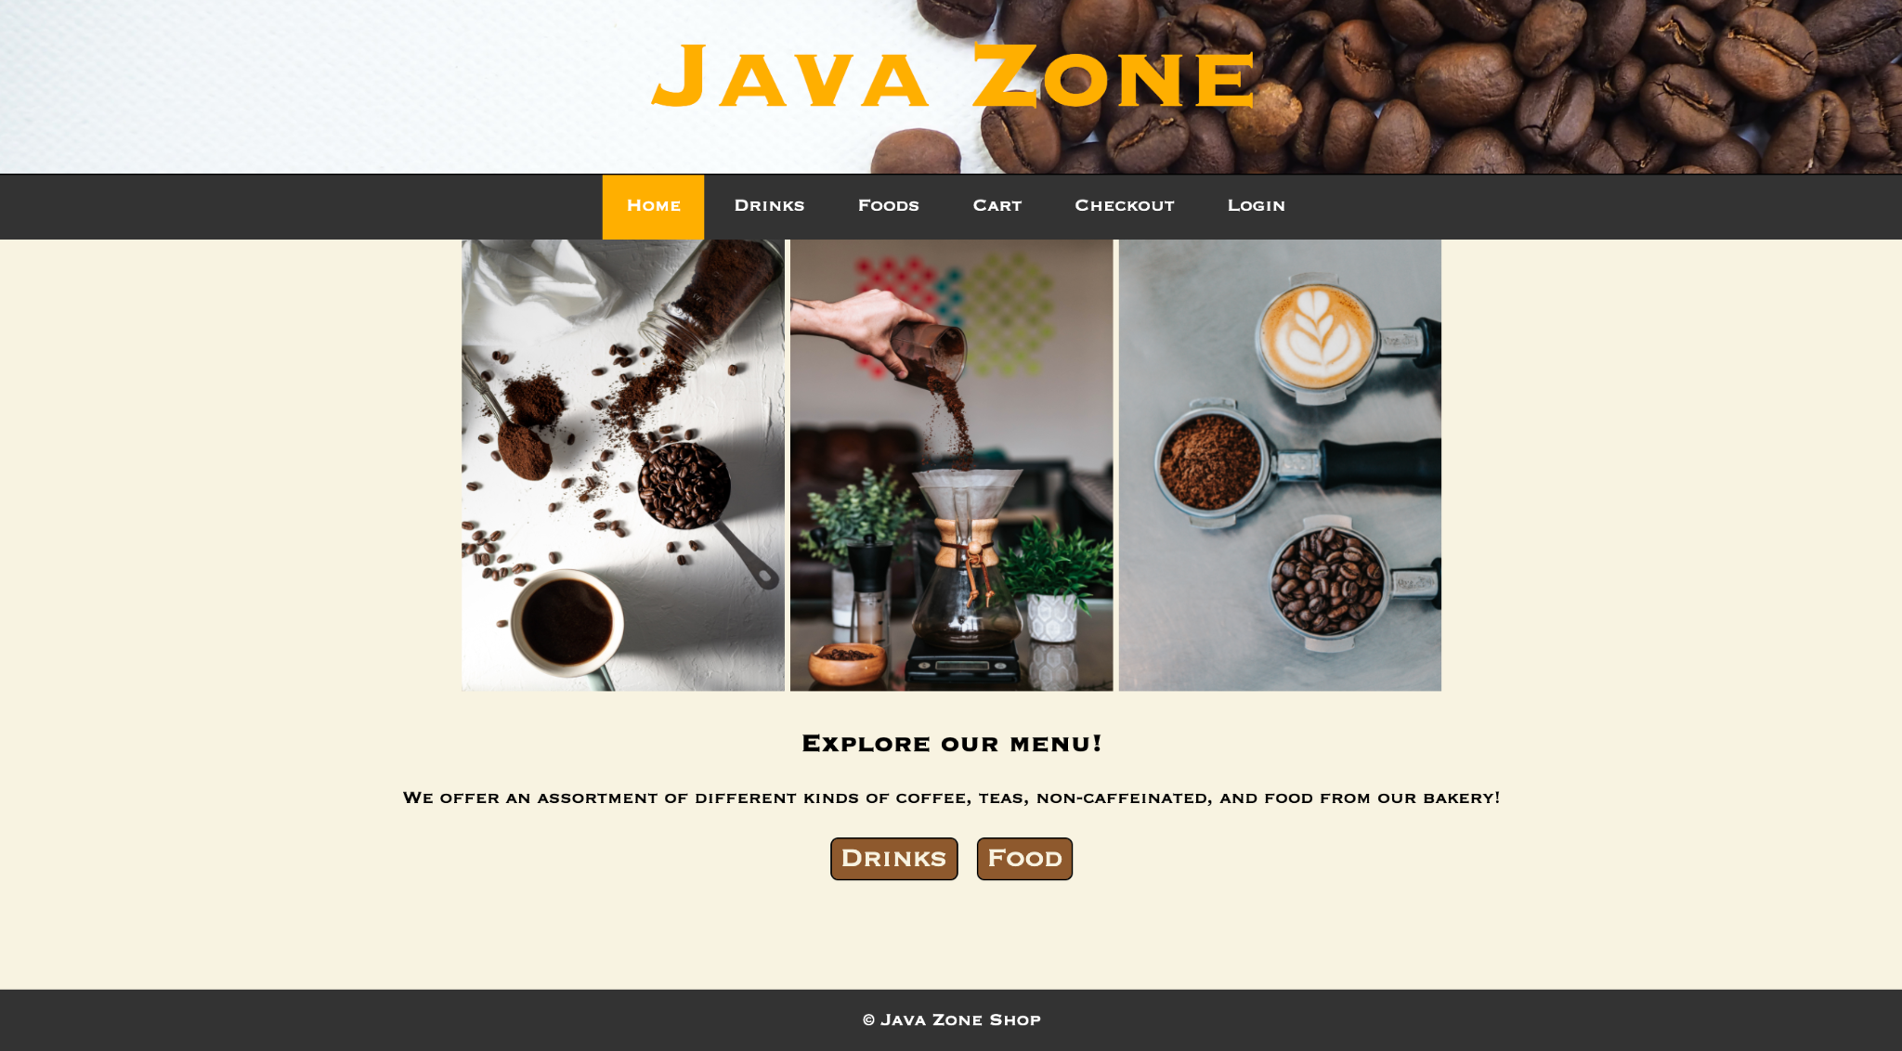
Notes:
Home page (entry point to project)

Slide 14
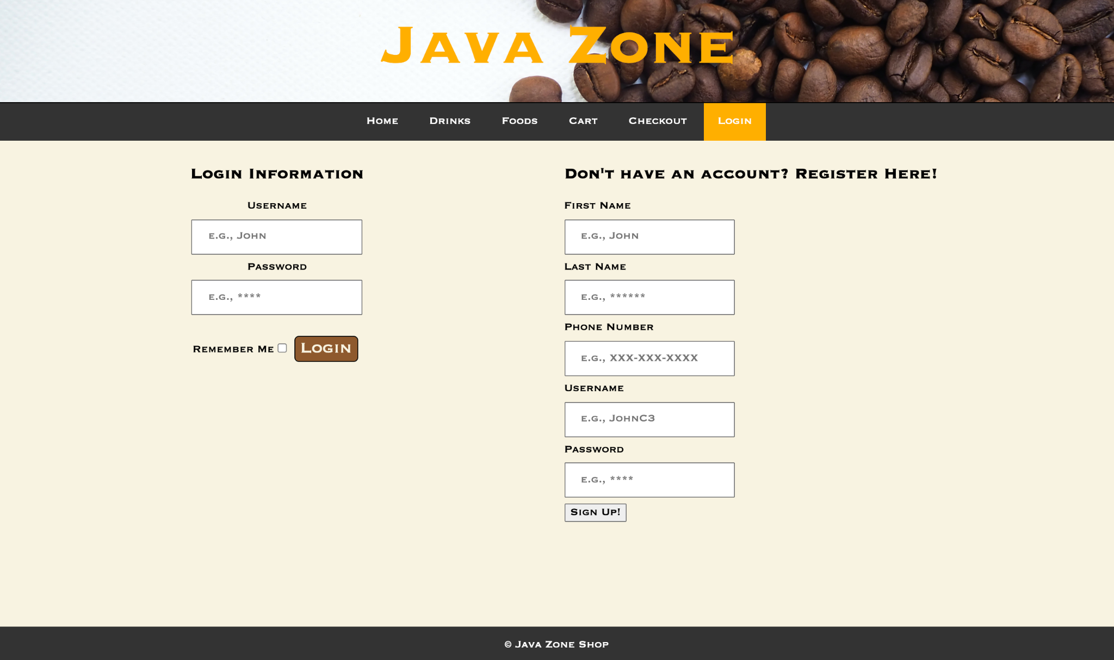
Notes:
Login/register- NEEDS TO UPDATED

Slide 15
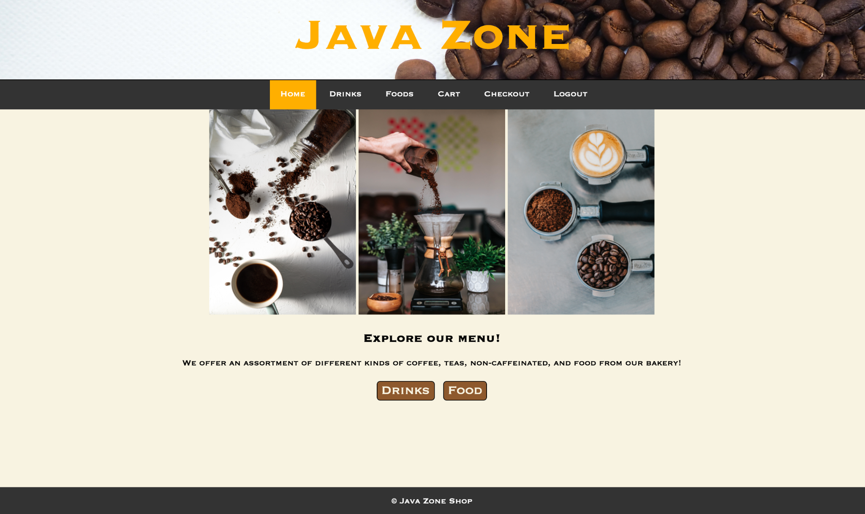
Notes:
-After a user logs in

Slide 16
Notes:
Drink page

Slide 17
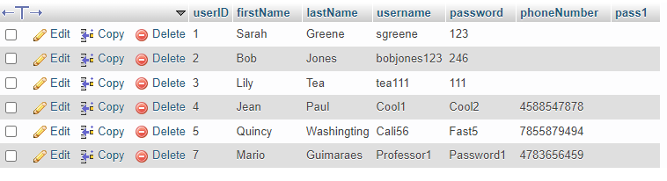
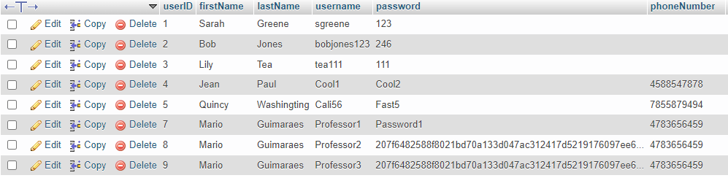
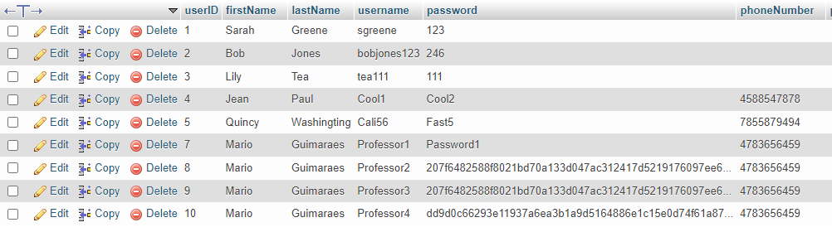
Before Hash
After Hash
After Hash and Salt
Notes:
Andrew

Slide 18
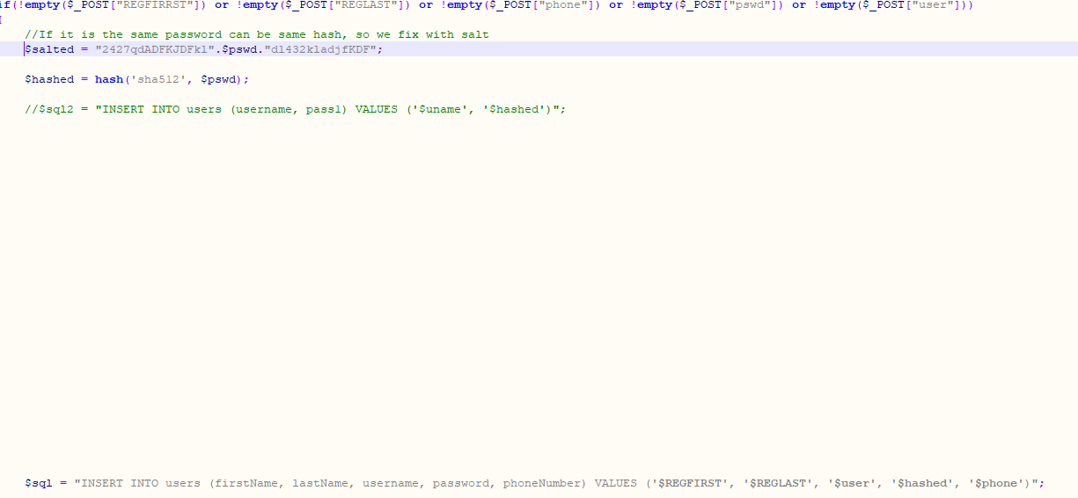
Notes:
Andrew

Slide 19
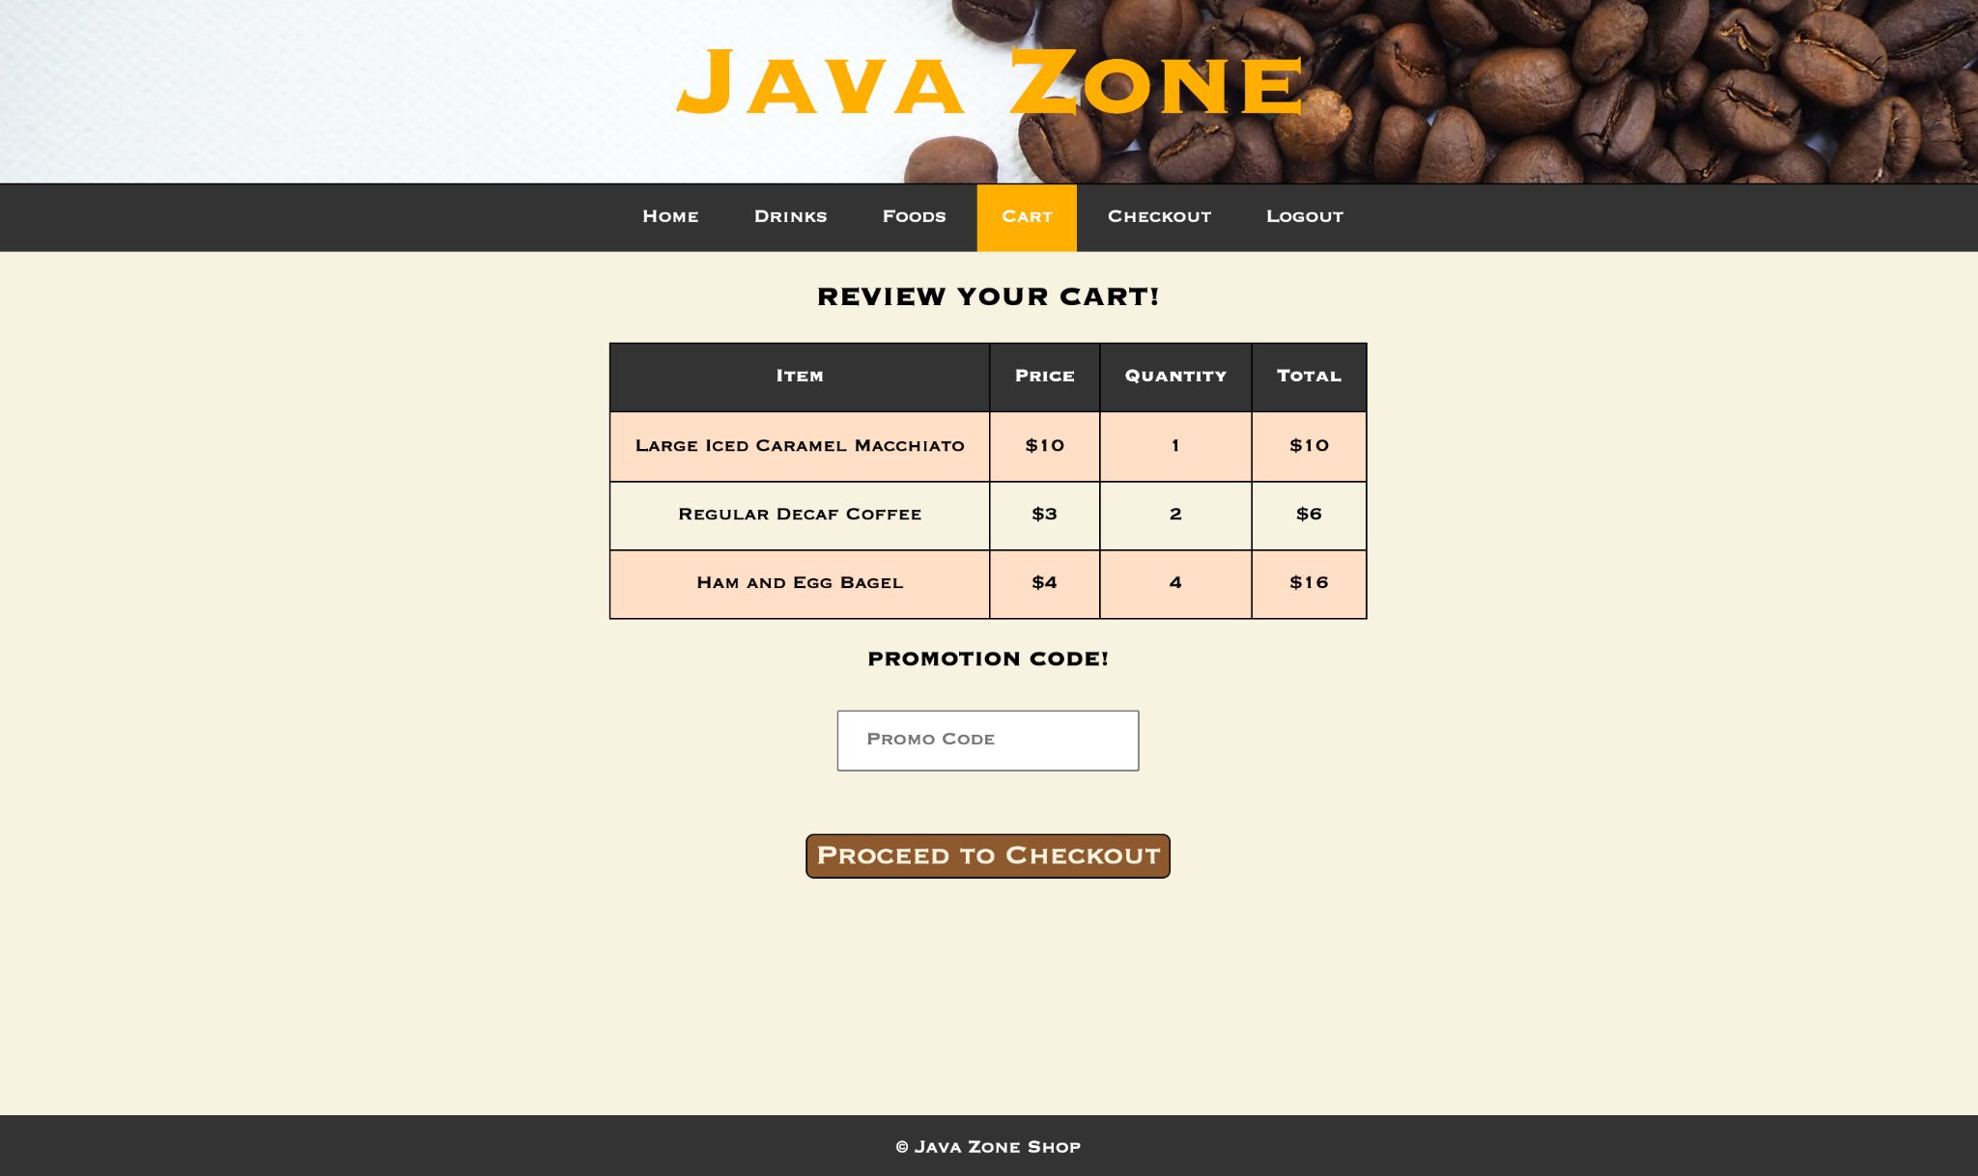
Notes:
Cart page

Slide 20


Problems
Resolutions
Time management
Figuring out PHP
Finalizing the DB
Having weekly meetings to discuss progress
Using Assignment 13 as a guide
Walking through code/any issues together
Discussing the pros/cons of our thoughts for the DB set up
Notes:
Andrew
https://encrypted-tbn0.gstatic.com/images?q=tbn:ANd9GcQtHMiM0kbnqkVuY0X85r93u22-c1GO9pwO-A&usqp=CAU
https://imagesvc.meredithcorp.io/v3/mm/image?q=85&c=sc&poi=face&w=1600&h=800&url=https%3A%2F%2Fstatic.onecms.io%2Fwp-content%2Fuploads%2Fsites%2F9%2F2019%2F05%2FThe-Wydown-1-FT-BLOG0519.jpg

Slide 21
Results/Conclusions
☕ Importance of teamwork and communication
☕ The value of making a group project a priority
☕ Fully functional website that epitomizes an online coffee shop
☕ Learning how to use HTML, PHP, CSS, and SQL together
Notes:
Sarah

Slide 22

Questions?
Notes:
https://media.istockphoto.com/photos/happy-coffee-cup-picture-id508347326?k=20&m=508347326&s=612x612&w=0&h=phdf_0eKqIbCj2ayXuXRktf8JGugJqFXdi6A8gBL6vU=

